Slide 1


Slide 2
Continuous Everything: Visual Studio Mobile Center
Keith Ballinger, Principal Director
Mobile Center

Slide 3
The problem with app development

Slide 4
Typical Day
Code Awesome Features

Slide 5
Typical Day
The most important part of your day.
☕️

Slide 6
Typical Day
hacker news

Slide 7
Typical Day
hacker news

Slide 8
Typical Day
hacker news

Slide 9
Typical Day
build

Slide 10
Typical Day
unit test

Slide 11
Typical Day
manual test

Slide 12
Typical Day
beta test

Slide 13
Typical Day
triage

Slide 14
Typical Day
debug

Slide 15
TYPICAL DAY

Slide 16
Typical Day
Wash.
Rinse.
Repeat.

Slide 17
Typical Day

Slide 18
Code Awesome Features
Overhead

Slide 19
The problem with app development is too much time wasted

Slide 20
Our Mission:

Slide 21
Make developers more productive

Slide 22






HockeyApp
Xamarin Test Cloud
Xamarin Insights
Distribution • Crashes • Analytics
Device Tests
Crashes • Analytics
Visual Studio Mobile Center
Azure Mobile Engagement
Azure App Service
CodePush
Analytics • Push
Tables • Auth • Push
Distribution
Notes:
Talk about how our teams and product came together.
We’ve taken these Microsoft products which are leading services in their specific part of the mobile development lifecycle and we’ve brought it all together. Into Visual Studio Mobile Center. A mission control for all your apps. A place where all these service seamlessly integrate to make the cycle easier and faster for developers. Developers of all kinds regardless of which platforms their developing for. The value of Mobile Center is reaching developers who aren’t our typical Microsoft customers by providing the highest quality services in the smoothest configuration. We’re giving them an end-to-end solution where they can use all of it or pick what they want, all while driving Azure attachment.

Slide 23
Customers first

Slide 24
Let developers focus on their apps, not DevOps

Slide 25
Principles
UNIX philosophy of powerful, single-purpose services that can ‘pipe’ together
API first
Customers own their data
Great experience across all touchpoints
Notes:
Each beacon service supports these pillars
Stand alone + together

Slide 26
Direct engagement with customers

Slide 28
Connecting with the cloud

Slide 29
File Storage
Xamarin Test Cloud Migration
Functions
tvOS
Native Tester Apps
General Availability
Identity
Pre & Post Build Scripts
Data Export
Unity
Webhooks
Events before Crash
VSTS Integration
Active Directory Groups
Roadmap
Nuget Caching
Xcode 9
Auto Provisioning
Teams
WPF
Publish to Stores
Document Storage
Handled Exceptions
Bug Tracker Integration
WinForms
Distribution Statistics
macOS
JavaScript Source Maps

Slide 30
Developers can focus on delivering more value

Slide 31
Code Awesome Features
Overhead

Slide 32
Code Awesome Features
Overhead

Slide 33
Code Awesome Features
Overhead

Slide 34
Sign up today
aka.ms/mobile-center

Slide 35
Q & A
Notes:
We’ve taken these Microsoft products which are leading services in their specific part of the mobile development lifecycle and we’ve brought it all together. Into Visual Studio Mobile Center. A mission control for all your apps. A place where all these service seamlessly integrate to make the cycle easier and faster for developers. Developers of all kinds regardless of which platforms their developing for. The value of Mobile Center is reaching developers who aren’t our typical Microsoft customers by providing the highest quality services in the smoothest configuration. We’re giving them an end-to-end solution where they can use all of it or pick what they want, all while driving Azure attachment.

Slide 36

June Cho Enterprise Mobile App Dev App Innovation | Global Black Belt

Slide 37
Agenda
Time | Topic | Speaker
9:00-9:30am | Welcome Statement | Keith Ballinger
9:30-10:30am | Setup, Build, and Test | Nikhil Keeppanasseril and Sweekriti Satpathy
10:30-10:45am | BREAK
10:45-11:45am | Distribute, Push, Analytics, and Crash | Derek Loar, Trevor Moore, and Dimah Zaidalkilani
11:45-12:45pm | Working Lunch | Chris Reichard
12:45-1:30pm | Machine Learning | Anuj Bhatia
1:30-2:15pm | Cognitive Services | Michael Watson
2:15-2:30pm | BREAK
2:30-4:00pm | Hands-On with Sentiment App | Mahdi Alirezaie
4:00-5:00pm | Closing Statement | Gifts | June Cho and ArcTouch
Dimah Zaidalkilani

Slide 38
Nikhil Keeppanasseril App. Innovation Specialist Global Black Belt

Slide 39
Getting Started
Log in to https://www.visualstudio.com/vs/mobile-center/
Connect directly with Github, your Microsoft login or new sign-up
Add new App → choose OS/platform
Build:
Select a service
Select Branch
Configure and build

Slide 40
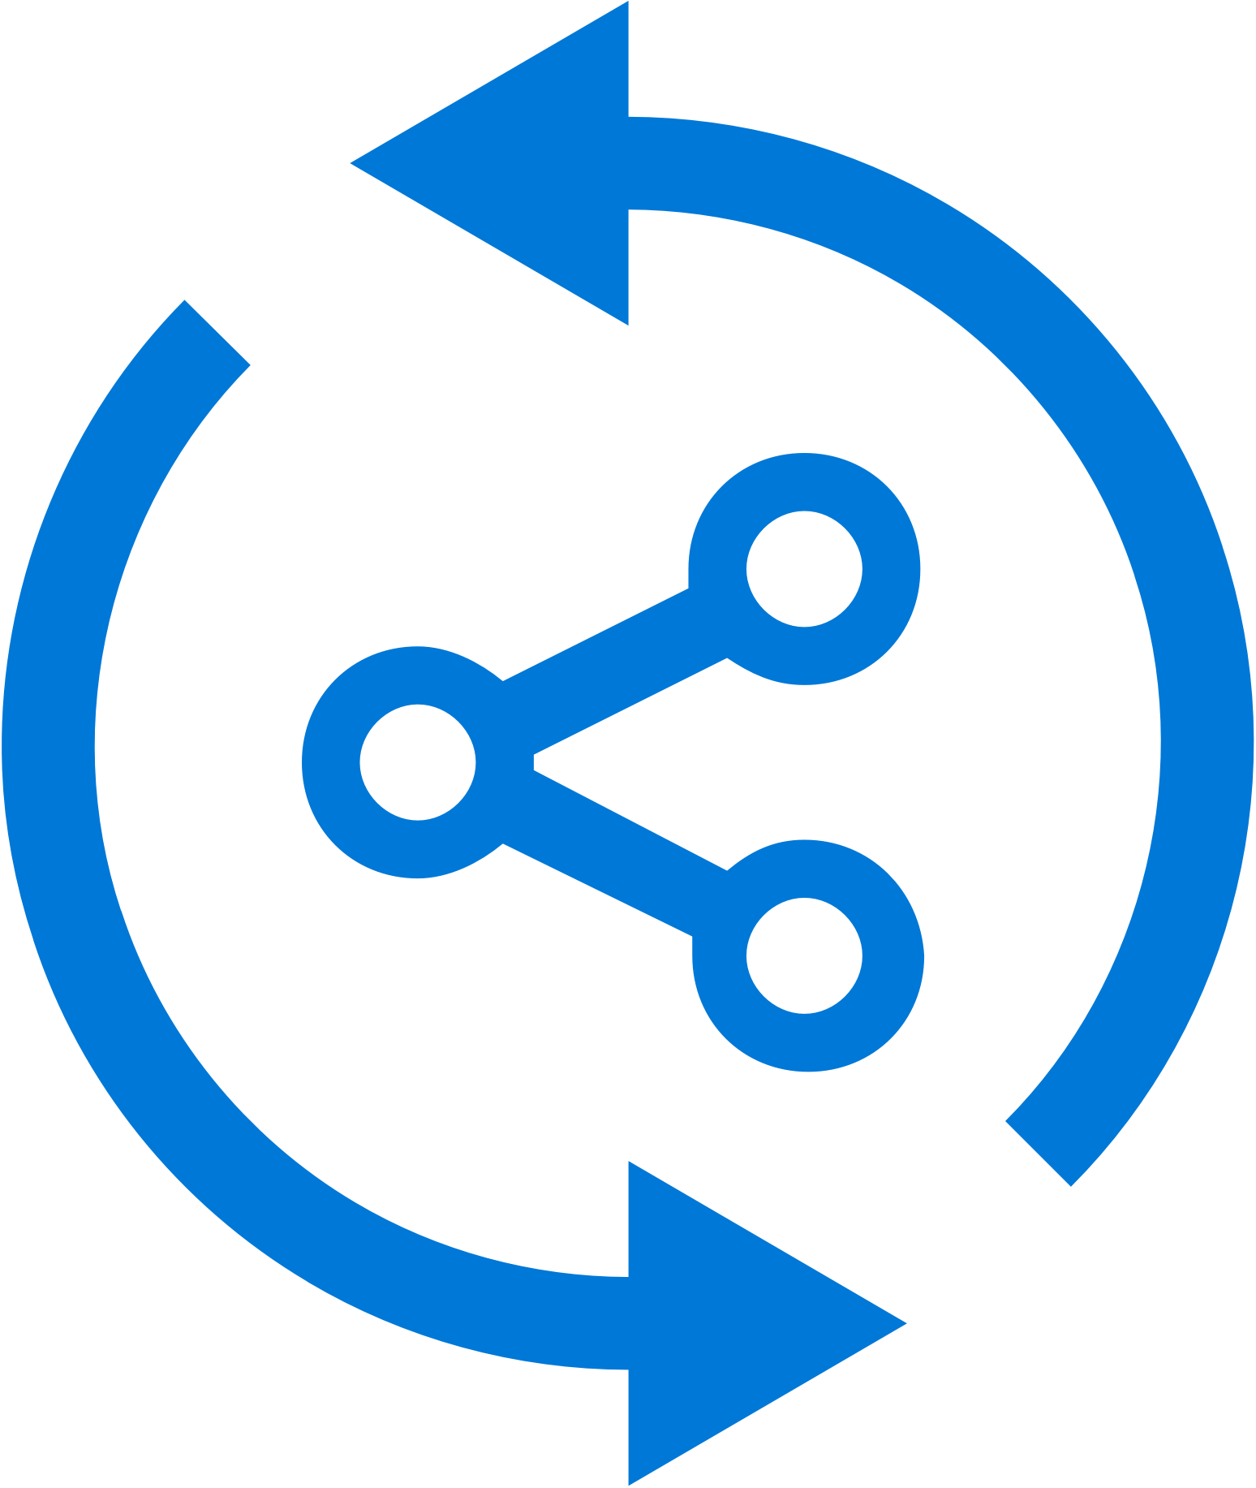


Mobile Center: Build
Build-on-push
With just a few steps automatically build apps with every commit, and generate packages to test and distribute
Work with existing tools
Connect existing repositories in GitHub, Bitbucket, and Visual Studio Team Services with just a few clicks
Build securely in the cloud
Each build is run on a separate, clean virtual machine hosted on our secure cloud servers
Notes:
Each build is run on a separate, clean virtual machine and no other user has access to this virtual machine. Once the build is completed, the virtual machine is discarded and all files removed. The files resulting from the build (log files, application files, symbol files) are stored on Mobile Center servers.

Slide 41
Trevor Moore App. Innovation Specialist Global Black Belt

Slide 42
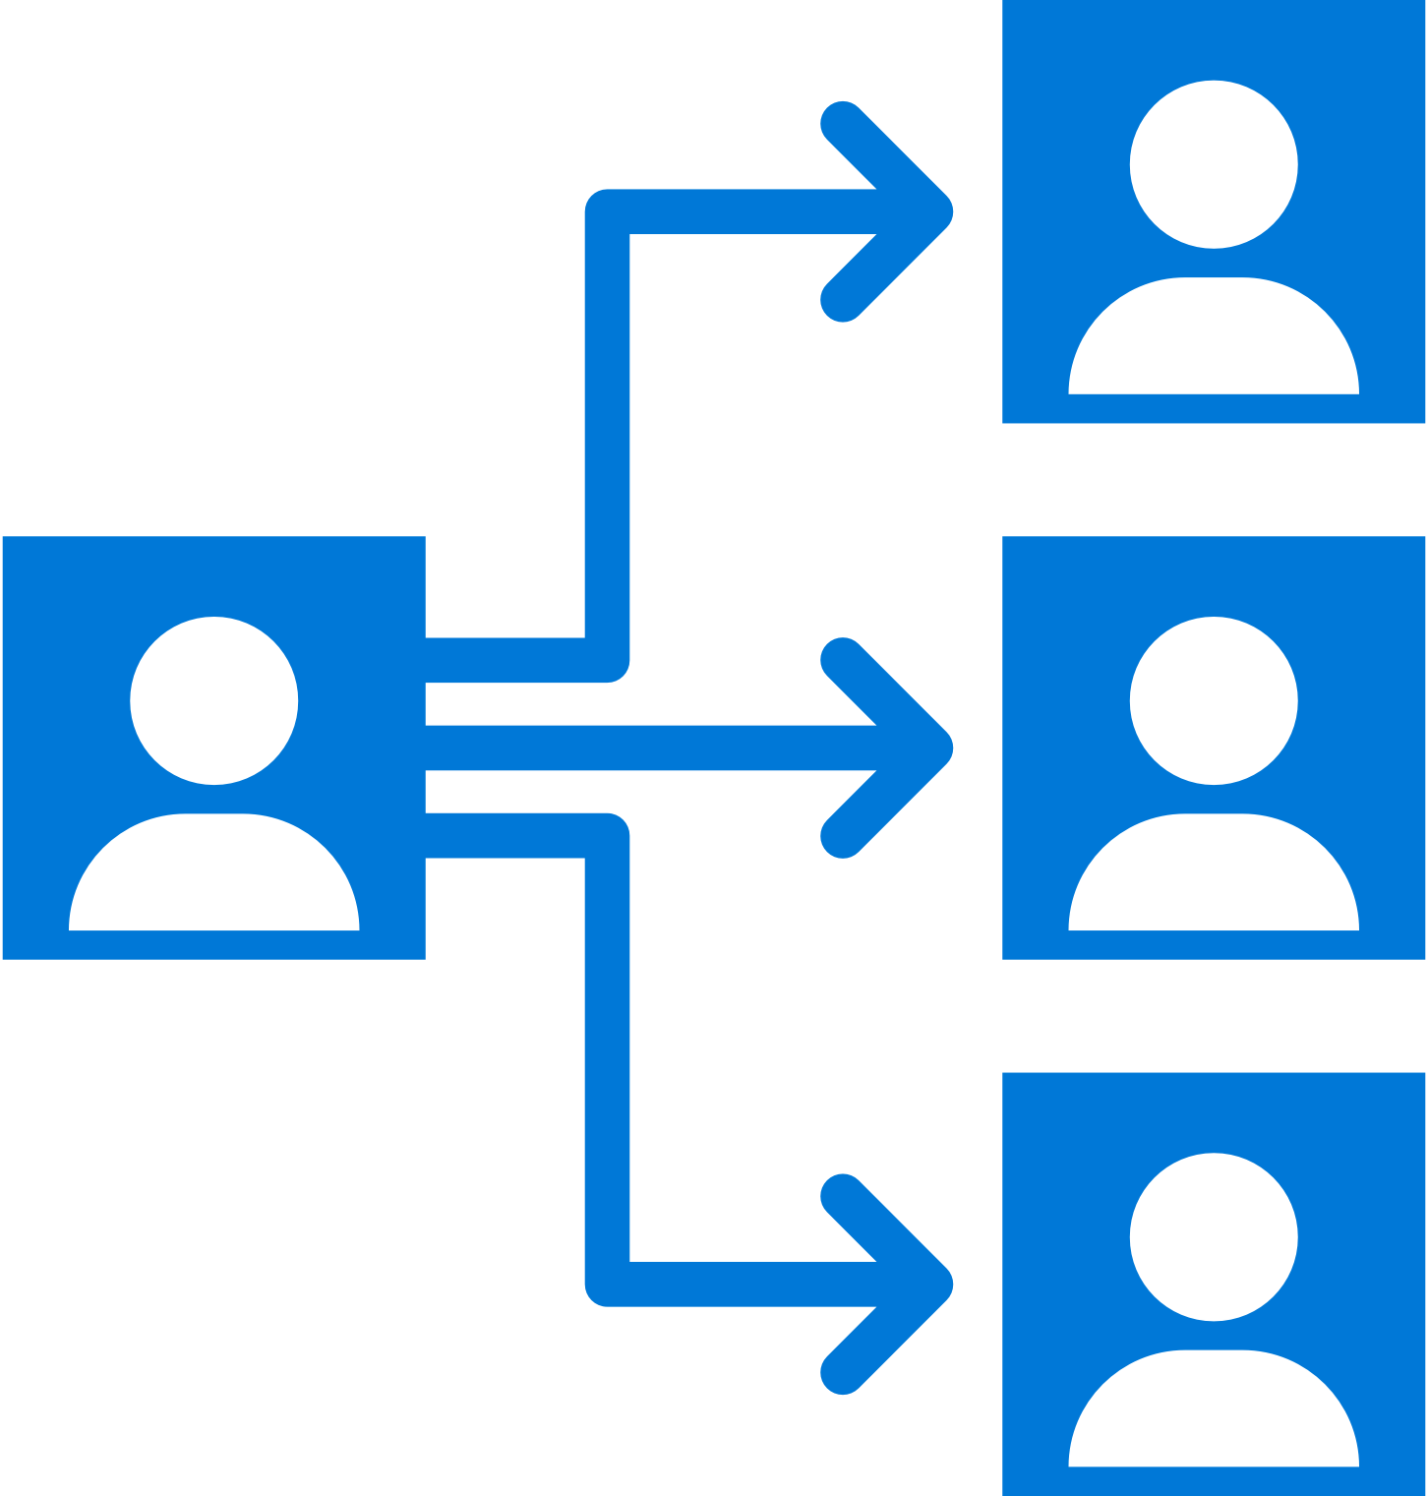

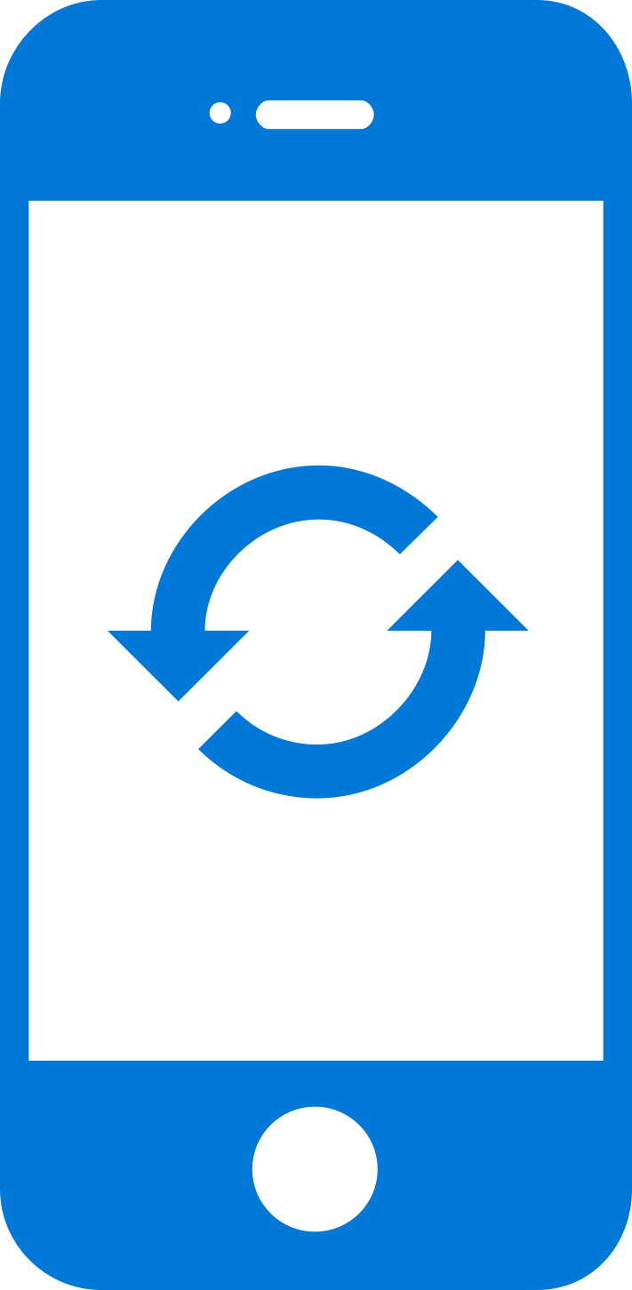
Mobile Center: Distribute
Instantly distribute apps
Quickly get apps in the hands of your beta testers on multiple device platforms
Create targeted distribution groups
With categorized groups of users, send specific builds to specific groups and devices
Send in-app updates
Notify beta testers as soon as a new build is available, right inside the app

Slide 43
Getting Started
Distributing with Mobile Center is easy, and only requires a few steps. No need for an SDK. Just the application binary.
Add users to grant access to all releases.
Create Distribution Groups to manage access.
Upload a new application release.
At the completion of the upload an email will be sent to all users of the app to notify them of the new release.
Install the release onto your device by clicking on the link in the email.
Enable In-App Updates to help your users stay always on the latest release.

Slide 44
Derek Loar App. Innovation Specialist Global Black Belt

Slide 45


Mobile Center: Push Notifications
push
Push notification services
(Apple and Google)
push
push
Notification
Hubs
Visual Studio
Mobile Center
tokens
Notes:
How many of you are involved in mobile app dev?
How many of your apps have push notifications?
Big point of your mobile apps are to engage user and customers. Push notifications helps do that.

Slide 46

Mobile Center: Push Notifications
Fast and easy to setup
Just a few lines of code in your app. No need to specify format for iOS, Android and Windows.
Send to specific audiences
Target push notifications to specific users or devices
Fast and easy to send
Three easy steps: Compose, Target, and Review.
No need for technical skills!
Notes:
Visual Studio Mobile Center Push Notifications is really easy
-Just a few lines of code in your app
-No need to specify format for Android, iOS or Windows
-and I’ll show you how easy it is to target and send notifications to your users
Difference in Push Notifications between Notification Hub and MC

Slide 47
Visual Studio Mobile Center
Sweeky Satpathy
MobCAT Ninja

Slide 48
Importance of Testing
Verify App Integrity
UI loads as expected on different sized screen
App performs as expected on different CPUs
Accessible UI
Features work as per User Flows
Useable Functionality
Testing as part of CI
Reliable Development Cycle

Slide 49



Mobile Center: Test
Release faster
Shrink release times significantly and push new apps out faster
Ship high quality apps Ensure the highest quality user experience that keeps users continuously engaged
Engage a broad audience
Test on a broad range of devices to make sure apps work on your users’ devices
Create new features Spend less time fixing bugs, and more time creating value

Slide 50
Supported Testing Platforms
Xamarin.UITest
Tests written in C#
Supports Xamarin apps, Native (Android, iOS) Apps, React Native Apps, Hybrid Apps
XCUITest
Tests written in Swift
Supports native iOS apps
Espresso
Tests written in Java
Supports native Android apps
Appium
Tests written in Java
Supports native (Android and iOS) apps , Xamarin Apps, React Native Apps, Hybrid Apps

